Slide 1
Medium-Sized Switched Network Construction
Implementing VLANs and Trunks

Slide 2
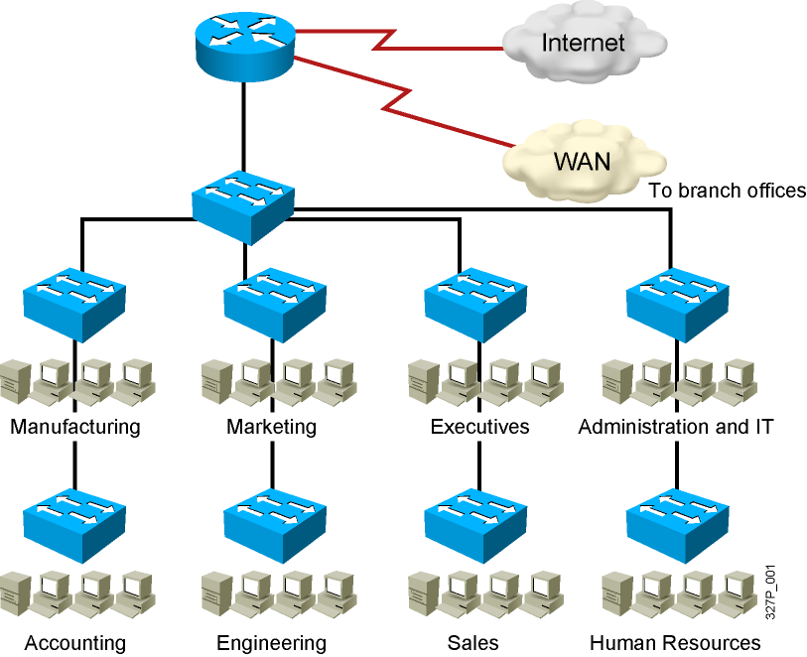
Issues in a Poorly Designed Network
Unbounded failure domains
Large broadcast domains
Large amount of unknown MAC unicast traffic
Unbounded multicast traffic
Management and support challenges
Possible security vulnerabilities

Slide 3
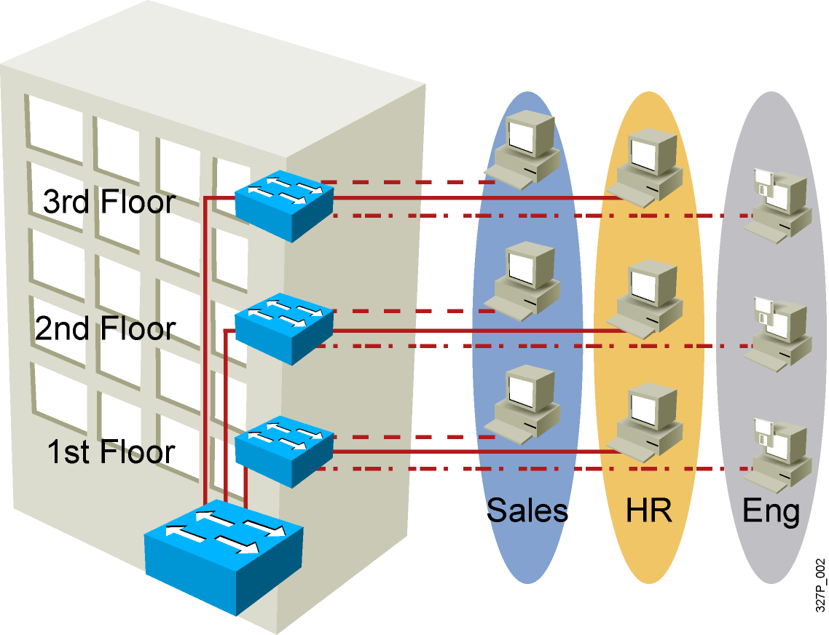
VLAN Overview
Segmentation
Flexibility
Security
VLAN = Broadcast Domain = Logical Network (Subnet)
Notes:
Purpose:
Emphasize: A VLAN is a broadcast domain.
Note: In order to have inter-VLAN communications, a router is required.

Slide 4
Designing VLANs for an Organization
VLAN design must take into consideration the implementation of a hierarchical network addressing scheme.
The benefits of hierarchical addressing are:
Ease of management and troubleshooting
Minimization of errors
Reduced number of routing table entries

Slide 5
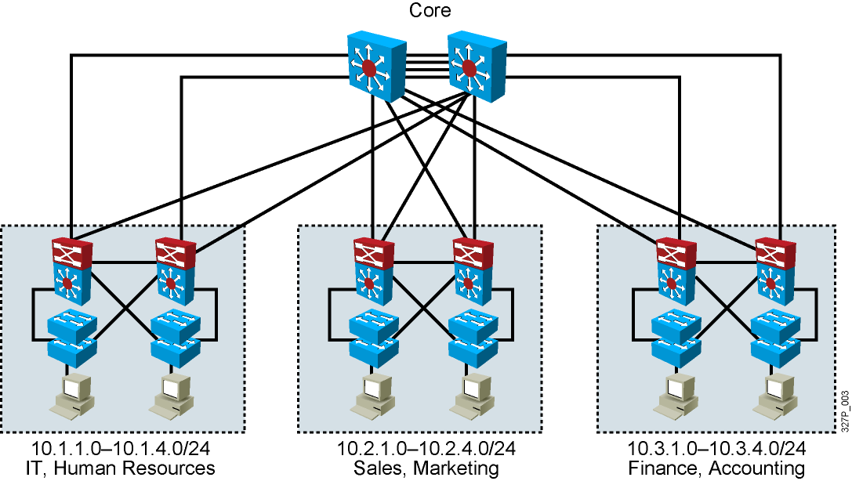
Guidelines for Applying IP Address Space
Allocate one IP subnet per VLAN.
Allocate IP address spaces in contiguous blocks.

Slide 6
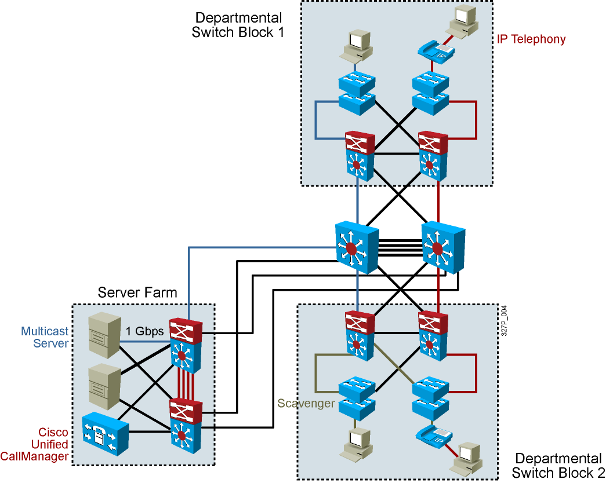
Network Traffic Types
Traffic types to consider when designating VLANs:
Network management
IP telephony
IP Multicast
Normal data
Scavenger class

Slide 7
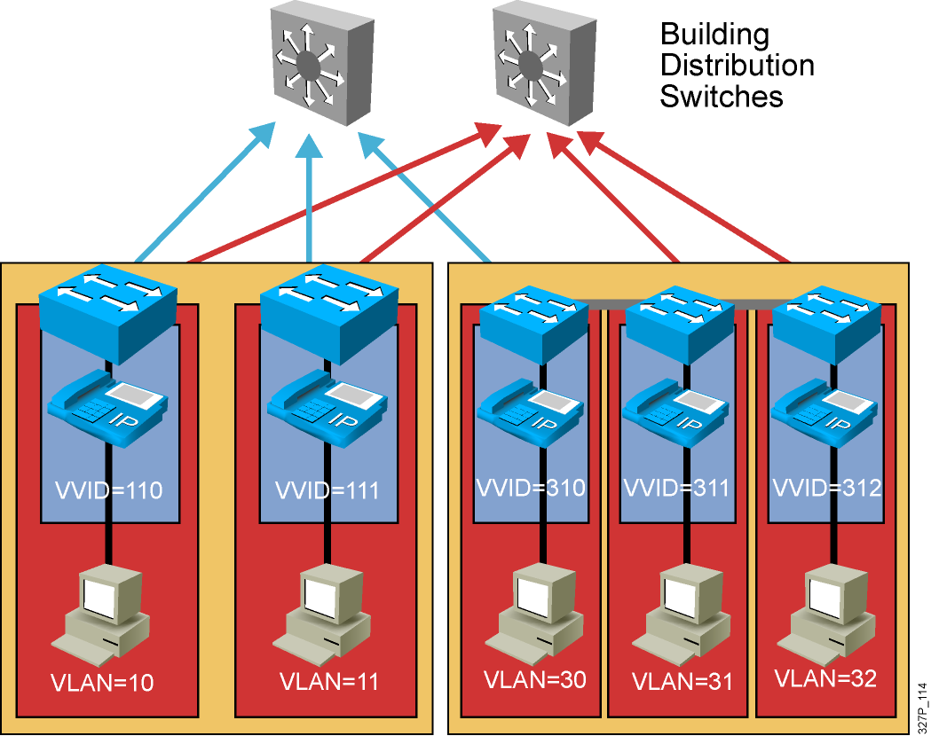
Advantages of Voice VLANs
Phones segmented in separate logical networks
Privides network segmentation and control
Allows administrators to create and enforce QoS
Lets administrators add and enforce security policies

Slide 8
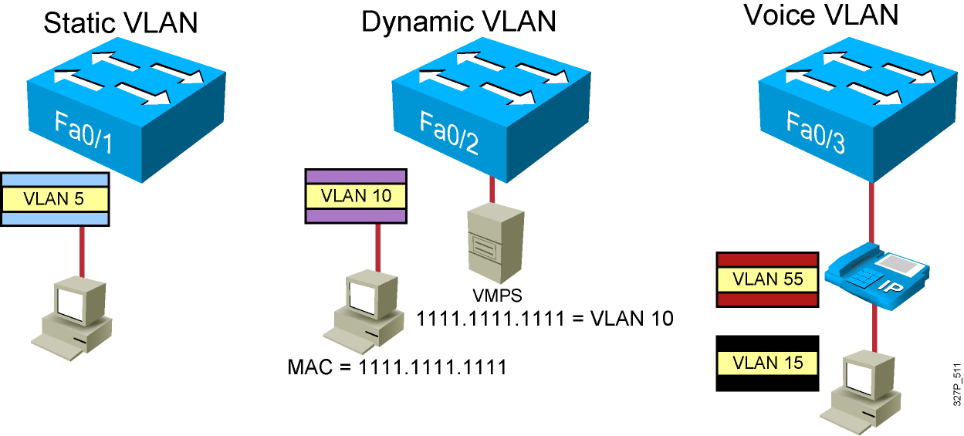
VLAN Membership Modes
Notes:
Note: Once a port has been assigned to a VLAN, it cannot send or receive traffic from devices in another VLAN without the intervention of a Layer 3 device like a router.
The 1900 can’t be configure as the VMPS.
A CiscoWorks 2000 or CWSI management station or a Catalyst 5000 switch can be configured as the VMPS.
In the future, dynamic VLANs may also offer membership based on other criteria such as protocol or application. Dynamic VLANs are covered in the Managing Cisco Switched Internetworks class.

Slide 9
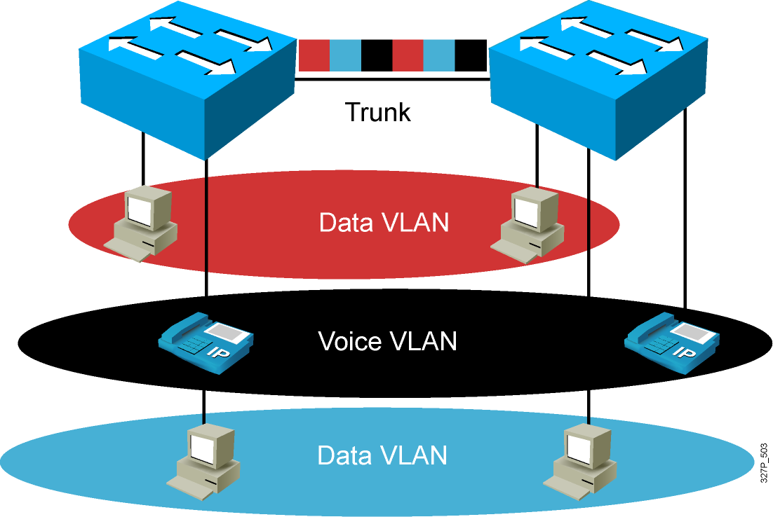
VLAN Operation

Slide 10
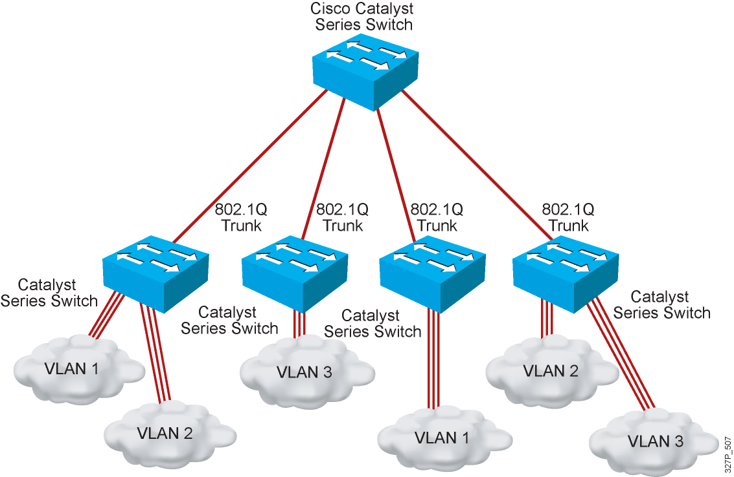
802.1Q Trunking

Slide 11
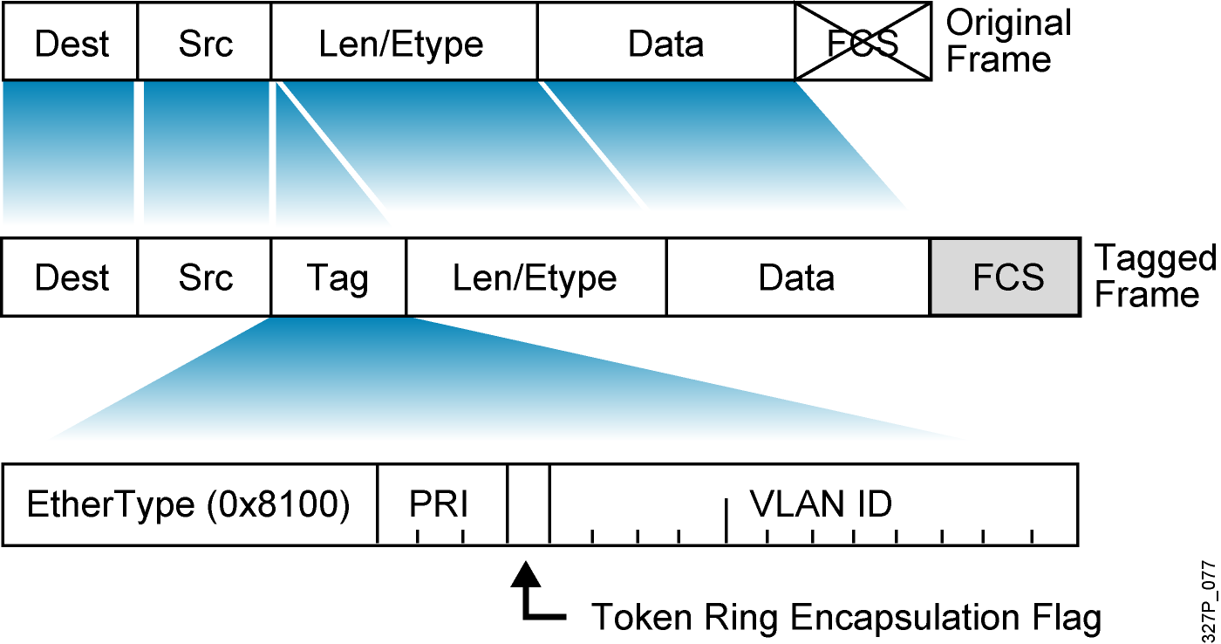
802.1Q Frame

Slide 12
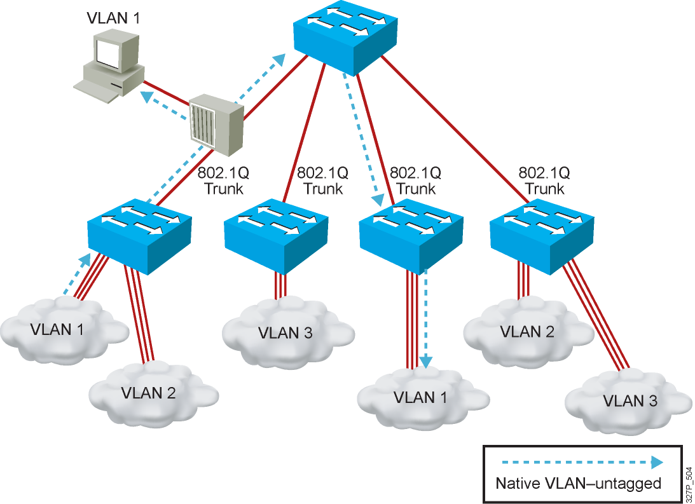
Understanding Native VLANs

Slide 13
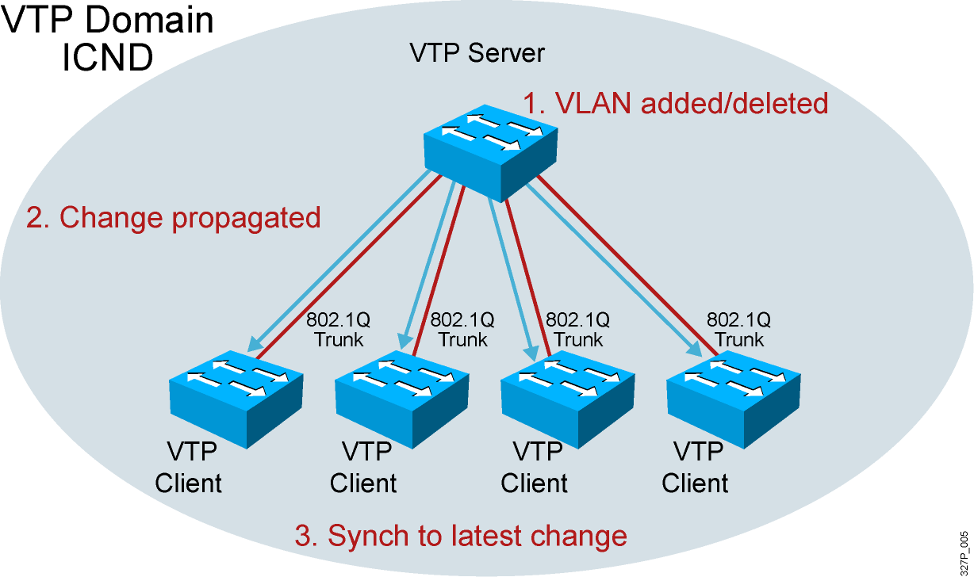
VTP Features

Slide 14
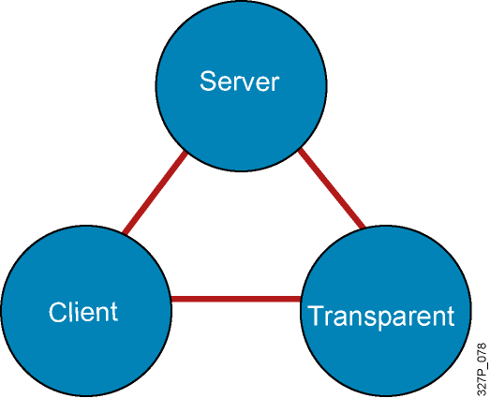
VTP Modes
Create VLANs
Modify VLANs
Delete VLANs
Sends and forwards advertisements
Synchronizes
Cannot create, change, or delete VLANs
Sends and forwards advertisements
Synchronizes
Create local VLANs only
Modify local VLANs only
Delete local VLANs only
Forwards advertisements
Does not synchronize
Notes:
Emphasize: Default VTP mode on the Catalyst switches is server. Be careful when adding new switches into an existing network. This is covered in more detail later.

Slide 15
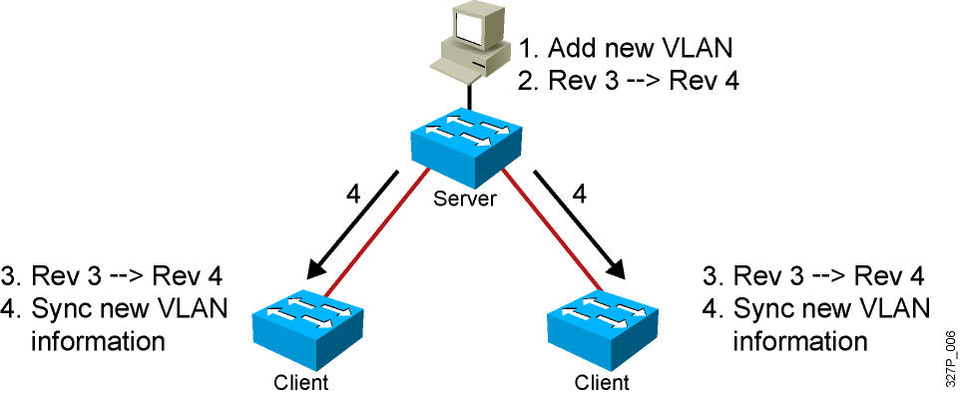
VTP Operation
VTP advertisements are sent as multicast frames.
VTP servers and clients are synchronized to the latest revision number.
VTP advertisements are sent every 5 minutes or when there is a change.
Notes:
Layer 2 of 2
Emphasize: The latest revision number is what the switches will synchronize to.

Slide 16
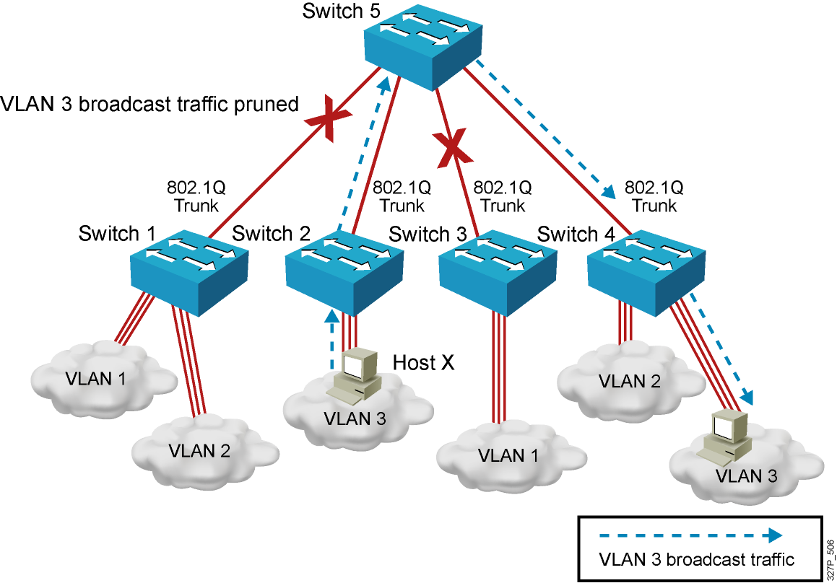
VTP Pruning

Slide 17
Configuring VLANs and Trunks
Configure and verify VTP.
Configure and verify 802.1Q trunks.
Create or modify a VLAN on the VTP server switch.
Assign switch ports to a VLAN and verify.
Execute adds, moves, and changes.
Save the VLAN configuration.

Slide 18
VTP Configuration Guidelines
VTP defaults for the Cisco Catalyst switch:
VTP domain name: None
VTP mode: Server mode
VTP pruning: Enabled or disabled (model specific)
VTP password: Null
VTP version: Version 1
A new switch can automatically become part of a domain once it receives an advertisement from a server.
A VTP client can overwrite a VTP server database if the client has a higher revision number.
A domain name cannot be removed after it is assigned; it can only be reassigned.
Notes:
Notes: All switches in a VTP domain must run the same VTP version.
The password entered with a domain name should be the same for all switches in the domain. If you configure a VTP password, the management domain will not function properly if you do not assign the management domain password to each switch in the domain.
A VTP version 2-capable switch can operate in the same VTP domain as a switch running VTP version 1, provided version 2 is disabled on the version 2-capable switch (version 2 is disabled by default).
Do not enable VTP version 2 on a switch unless all of the switches in the same VTP domain are version 2-capable. When you enable version 2 on a switch, all of the version 2-capable switches in the domain must have version 2 enabled. If there is a version 1-only switch, it will not exchange VTP information with switches with version 2 enabled.
If there are Token Ring networks in your environment, you must enable VTP version 2 for Token Ring VLAN switching to function properly.
Enabling or disabling VTP pruning on a VTP server enables or disables VTP pruning for the entire management domain.
In the lab, all the switches are set to VTP transparent mode.

Slide 19
Creating a VTP Domain
SwitchX# configure terminal
SwitchX(config)# vtp mode [ server | client | transparent ]
SwitchX(config)# vtp domain domain-name
SwitchX(config)# vtp password password
SwitchX(config)# vtp pruning
SwitchX(config)# end
Notes:
Layer 2 of 2
Note: The two commands shown in the slide can also be combined into one command:
vtp domain switchlab transparent

Slide 20
VTP Configuration and Verification Example
SwitchX(config)# vtp domain ICND
Changing VTP domain name to ICND
SwitchX(config)# vtp mode transparent
Setting device to VTP TRANSPARENT mode.
SwitchX(config)# end
SwitchX# show vtp status
VTP Version : 2
Configuration Revision : 0
Maximum VLANs supported locally : 64
Number of existing VLANs : 17
VTP Operating Mode : Transparent
VTP Domain Name : ICND
VTP Pruning Mode : Disabled
VTP V2 Mode : Disabled
VTP Traps Generation : Disabled
MD5 digest : 0x7D 0x6E 0x5E 0x3D 0xAF 0xA0 0x2F 0xAA
Configuration last modified by 10.1.1.4 at 3-3-93 20:08:05
SwitchX#
Notes:
240, 197, 102

Slide 21
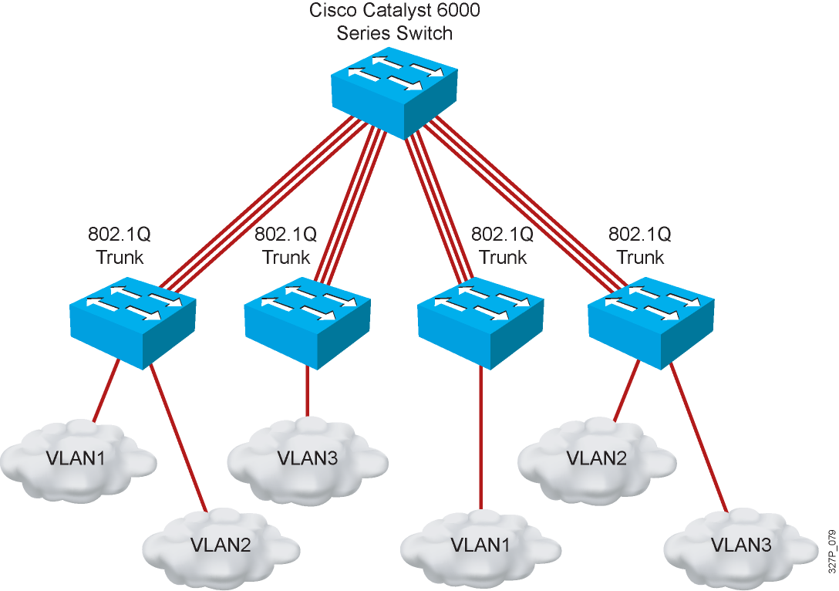
802.1Q Trunking Issues
Make sure that the native VLAN for an 802.1Q trunk is the same on both ends of the trunk link.
Note that native VLAN frames are untagged.
A trunk port cannot be a secure port.
All 802.1Q trunking ports in an EtherChannel group must have the same configuration.

Slide 22
Configuring 802.1Q Trunking
SwitchX(config-if)#
switchport mode {access | dynamic {auto | desirable} | trunk}
Configures the trunking characteristics of the port
SwitchX(config-if)#
switchport mode trunk
Configures the port as a VLAN trunk

Slide 23
Verifying a Trunk
SwitchX# show interfaces interface [switchport | trunk]
SwitchX# show interfaces fa0/11 switchport
Name: Fa0/11
Switchport: Enabled
Administrative Mode: trunk
Operational Mode: down
Administrative Trunking Encapsulation: dot1q
Negotiation of Trunking: On
Access Mode VLAN: 1 (default)
Trunking Native Mode VLAN: 1 (default)
. . .
SwitchX# show interfaces fa0/11 trunk
Port Mode Encapsulation Status Native vlan
Fa0/11 desirable 802.1q trunking 1
Port Vlans allowed on trunk
Fa0/11 1-4094
Port Vlans allowed and active in management domain
Fa0/11 1-13
Notes:
Layer 2 of 2
Note: The Catalyst 1900,at the time of the beta, only supports ISL trunking. It does not support 802.1Q trunking.

Slide 24
VLAN Creation Guidelines
The maximum number of VLANs is switch-dependent.
Most Cisco Catalyst desktop switches support 128 separate spanning-tree instances, one per VLAN.
VLAN 1 is the factory default Ethernet VLAN.
Cisco Discovery Protocol and VTP advertisements are sent on VLAN 1.
The Cisco Catalyst switch IP address is in the management VLAN (VLAN 1 by default).
If using VTP, the switch must be in VTP server or transparent mode to add or delete VLANs.
Notes:
Note: In the ICND lab, all the switches and routers are in VLAN1. The core server and the core router are in multiple VLANs. Each workgroup PC is on an unique VLAN.

Slide 25
Adding a VLAN
SwitchX# configure terminal
SwitchX(config)# vlan 2
SwitchX(config-vlan)# name switchlab99
Notes:
Layer 2 of 2

Slide 26
Verifying a VLAN
SwitchX# show vlan [brief | id vlan-id || name vlan-name]
SwitchX# show vlan id 2
VLAN Name Status Ports
---- -------------------------------- --------- -------------------------------
2 switchlab99 active Fa0/2, Fa0/12
VLAN Type SAID MTU Parent RingNo BridgeNo Stp BrdgMode Trans1 Trans2
---- ----- ---------- ----- ------ ------ -------- ---- -------- ------ ------
2 enet 100002 1500 - - - - - 0 0
. . .
SwitchX#
Notes:
Layer 2 of 2
Note:
Type: Default is Ethernet (other types are FDDI and Token Ring).
SAID: Is used for FDDI trunking.
MTU: Default is 1500 for Ethernet VLAN.
STP: The 1900 only supports 802.1d Spanning-Tree Protocol. It does not support DEC or IBM Spanning-Tree Protocol. Routers support all three Spanning-Tree Protocol standards.
Other parameters: Used for Token Ring or FDDI VLANs.

Slide 27
Assigning Switch Ports to a VLAN
SwitchX(config-if)#
switchport access [vlan vlan# | dynamic]
SwitchX# configure terminal
SwitchX(config)# interface range fastethernet 0/2 - 4
SwitchX(config-if)# switchport access vlan 2
SwitchX# show vlan
VLAN Name Status Ports
---- -------------------------------- --------- ----------------------
1 default active Fa0/1
2 switchlab99 active Fa0/2, Fa0/3, Fa0/4
Notes:
Layer 2 of 2
Note: In the lab, we will only be configuring static VLAN membership.

Slide 28
Verifying VLAN Membership
SwitchX# show vlan brief
SwitchX# show vlan brief
VLAN Name Status Ports
---- -------------------------------- --------- -------------------------------
1 default active Fa0/1
2 switchlab99 active Fa0/2, Fa0/3, Fa0/4
3 vlan3 active
4 vlan4 active
1002 fddi-default act/unsup
1003 token-ring-default act/unsup
VLAN Name Status Ports
---- -------------------------------- --------- -------------------------------
1004 fddinet-default act/unsup
1005 trnet-default act/unsup
Notes:
Layer 2 of 2
Emphasize: Port 1 = e0/1, ……. AUI = e0/25, A = fa 0/26, B = fa 0/27

Slide 29
Verifying VLAN Membership (Cont.)
SwitchX(config-if)#
show interfaces interface switchport
SwitchX# show interfaces fa0/2 switchport
Name: Fa0/2
Switchport: Enabled
Administrative Mode: dynamic auto
Operational Mode: static access
Administrative Trunking Encapsulation: dot1q
Operational Trunking Encapsulation: native
Negotiation of Trunking: On
Access Mode VLAN: 2 (switchlab99)
Trunking Native Mode VLAN: 1 (default)
--- output omitted ----
Notes:
Layer 2 of 2
Note: In the lab, we will only be configuring static VLAN membership.

Slide 30
Executing Adds, Moves, and Changes for VLANs
When using VTP, the switch must be in VTP server or transparent mode to add, change, or delete VLANs.
When you make VLAN changes from a switch in VTP server mode, the change is propagated to other switches in the VTP domain.
Changing VLANs typically implies changing IP networks.
After a port is reassigned to a new VLAN, that port is automatically removed from its previous VLAN.
When you delete a VLAN, any ports in that VLAN that are not moved to an active VLAN will be unable to communicate with other stations.

Slide 31
Summary
A poorly designed network has increased support costs, reduced service availability, and limited support for new applications and solutions.
VLANs provide segmentation and organizational flexibility.
Ethernet trunks carry the traffic of multiple VLANs over a single link and allow you to extend VLANs across an entire network.
VTP is a Layer 2 messaging protocol that maintains VLAN configuration consistency.

Slide 32
Medium-Sized Switched Network Construction
Routing Between VLANs

Slide 33
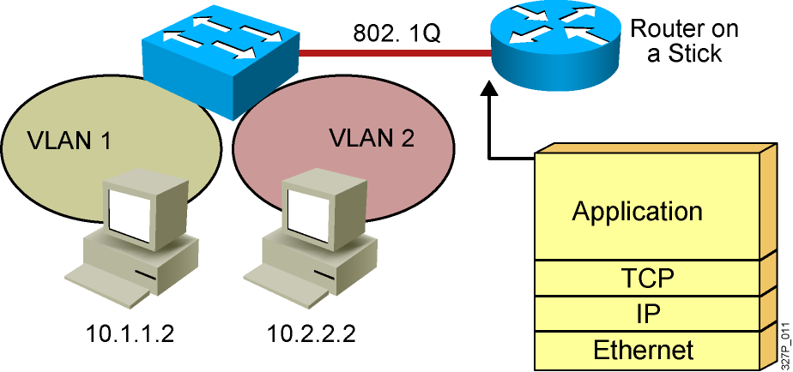
VLAN-to-VLAN Overview
Network layer devices combine multiple broadcast domains.
Notes:
Purpose: This figure shows a router on a stick being used to interconnect VLANs.
Emphasize: The VLANs are on different networks. Without a network layer device they could not communicate.
Review the protocols operating at each of the OSI layers.

Slide 34
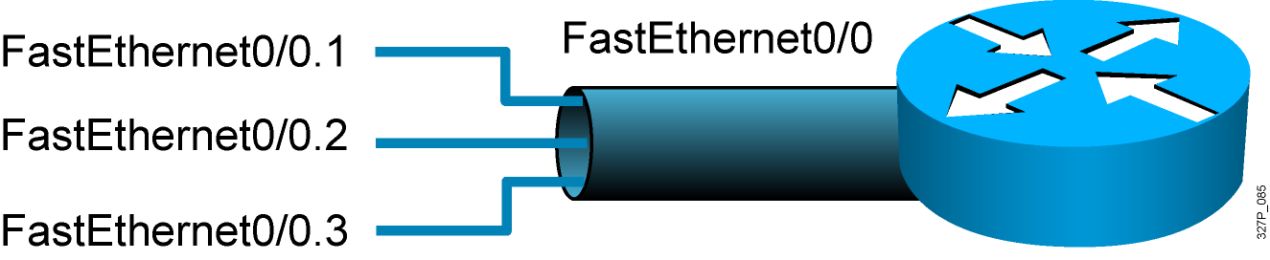
Dividing a Physical Interface into Subinterfaces
Physical interfaces can be divided into multiple subinterfaces.
Notes:
Purpose: This figure shows a subinterface example. Subinterfaces will be covered later in this course.
Emphasize: At this point, it is important for students to understand that if they want to connect multiple VLANs, they need a separate connection for each VLAN. This can be accomplished by establishing a physical connection for each VLAN that will interconnect with other VLANs, or by splitting a trunk into multiple, logical subinterfaces.

Slide 35
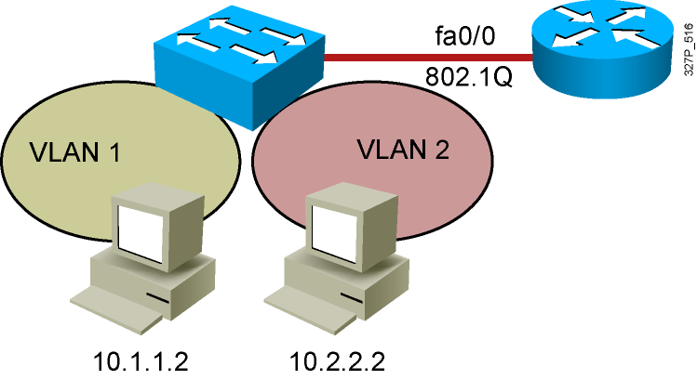
Routing Between VLANs with 802.1Q Trunks
interface fastethernet 0/0
ip address 10.1.1.1 255.255.255.0
interface fastethernet 0/0.2
ip address 10.2.2.1 255.255.255.0
encapsulation dot1q 2

Slide 36
Summary
Inter-VLAN routing using a router on a stick utilizes an external router to pass traffic between VLANs.
A router on a stick is configured with a subinterface for each VLAN and 802.1Q trunk encapsulation.

Slide 37
Medium-Sized Switched Network Construction
Improving Performance with Spanning Tree

Slide 38
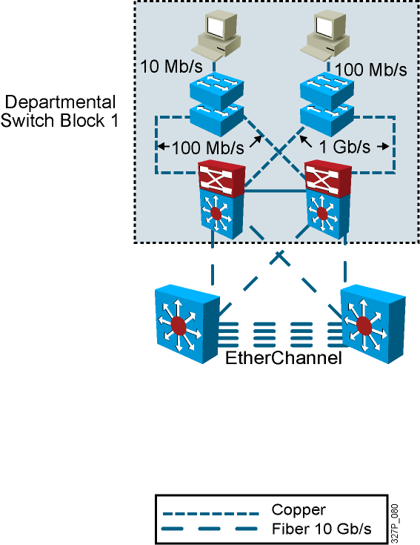
Interconnection Technologies
Technology | Use
Fast Ethernet | Connects end-user devices to the access layer switch
Gigabit Ethernet | Connects access switch to distribution switch and high use servers to switches
10-Gigabit Ethernet | Provides high-speed switch to switch links, backbones
EtherChannel | Provides high-speed switch to switch links, backbones with redundancy
Notes:
142,142,149

Slide 39
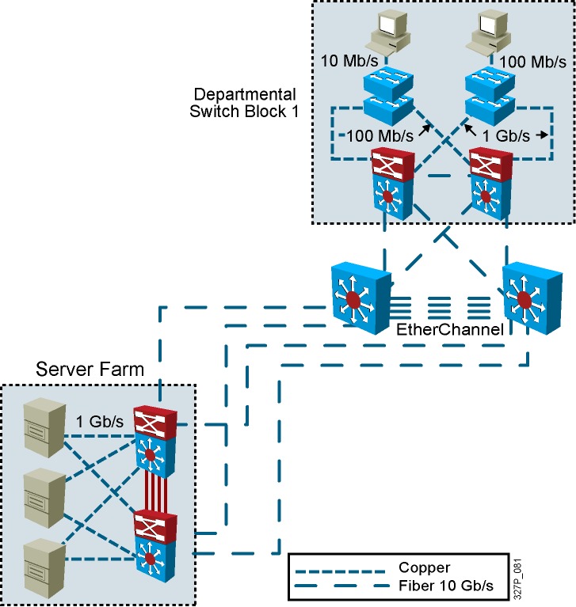
Determining Equipment and Cabling Needs
Each link provides adequate bandwidth for the total aggregate traffic over that link.

Slide 40
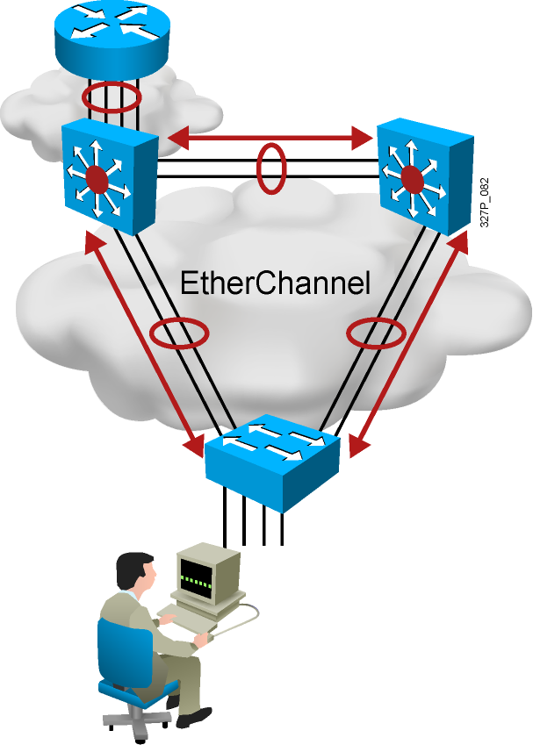
Advantages of EtherChannel
Logical aggregation of similar links between switches
Load-shares across links
Viewed as one logical port to STP
Redundancy

Slide 41
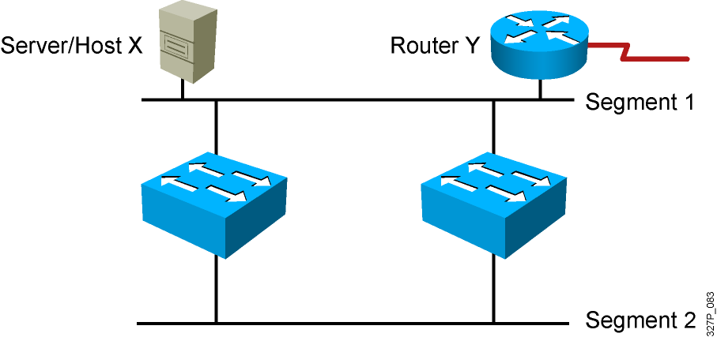
Redundant Topology
Redundant topology eliminates single points of failure.
Redundant topology causes broadcast storms, multiple frame copies, and MAC address table instability problems.
Notes:
Emphasize: Layer 2 has no mechanism (like a TTL) to stop loops.

Slide 42
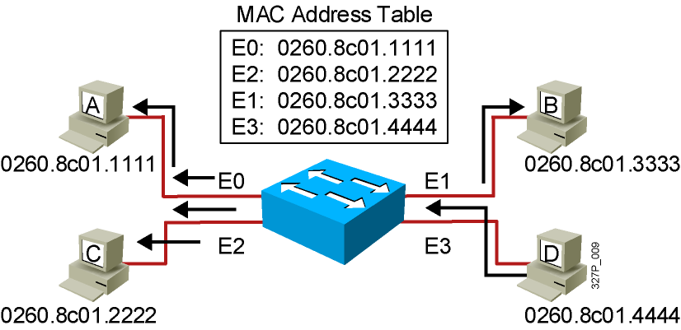
Broadcast Frames
Station D sends a broadcast frame.
Broadcast frames are flooded to all ports except the originating port.

Slide 43
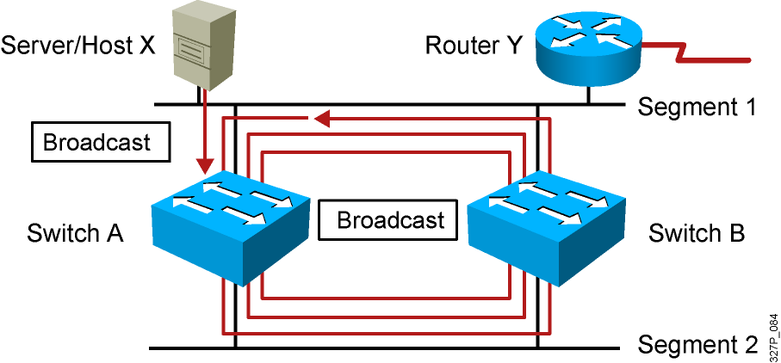
Broadcast Storms
Host X sends a broadcast.
Switches continue to propagate broadcast traffic over and over.
Notes:
Layer 3 of 3
Emphasize: Layer 2 has no TTL mechanism to stop looping frames.

Slide 44
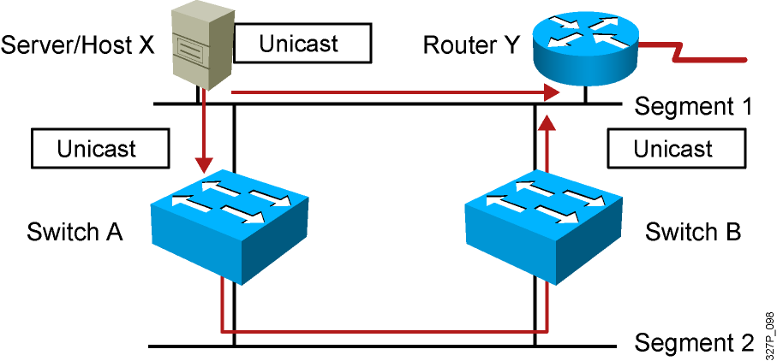
Multiple Frame Copies
Host X sends a unicast frame to router Y.
The MAC address of router Y has not been learned by either switch.
Router Y will receive two copies of the same frame.
Notes:
Layer 2 of 2

Slide 45
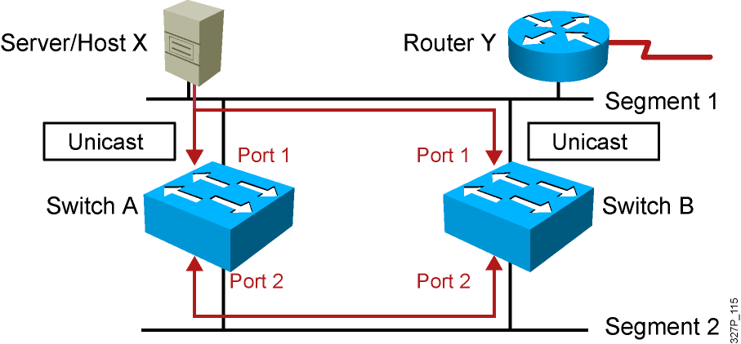
MAC Database Instability
Host X sends a unicast frame to router Y.
The MAC address of router Y has not been learned by either switch.
Switches A and B learn the MAC address of host X on port 1.
The frame to router Y is flooded.
Switches A and B incorrectly learn the MAC address of host X on port 2.
Notes:
Layer 2 of 2

Slide 46
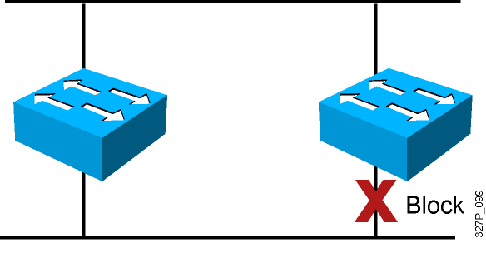
Loop Resolution with STP
Provides a loop-free redundant network topology by placing certain ports in the blocking state
Published in the IEEE 802.1D specification
Enhanced with the Cisco PVST+ implementation
Notes:
Emphasize: A looped topology is often desired to provide redundancy, but looped traffic is undesirable. The Spanning-Tree protocol was originally designed for bridges. Today, it is also applied to LAN switches and routers operating as a bridge. Spanning-Tree protocol ensures that all bridged segments are reachable but any points where loops occur will be blocked.

Slide 47
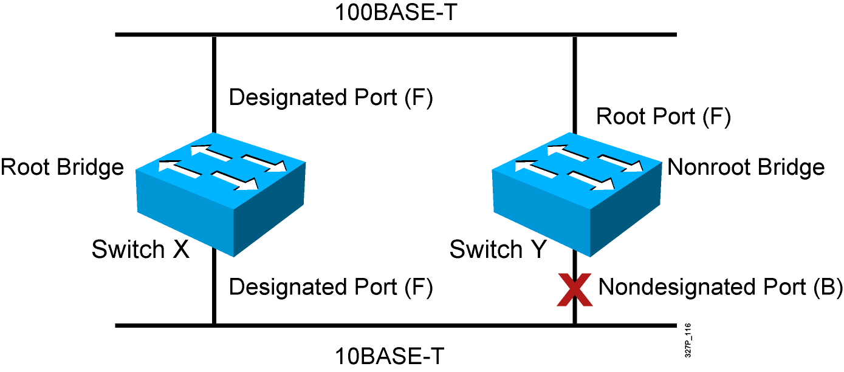
Spanning-Tree Operation
One root bridge per broadcast domain.
One root port per nonroot bridge.
One designated port per segment.
Nondesignated ports are unused.
Notes:
Emphasize: The three general rules when dealing with STP are as follows:
1. One root bridge per network. The root is the bridge with the lowest bridge ID. All the ports on the root bridge are designated ports (forwarding).
2. For every non-root bridge, there is a root port (forwarding). The root port is the port with the lowest accumulated path cost to the root bridge.
3. For every segment, there is only one designated port. The designated port forwards traffic for the segment. The designated port has the lowest accumulated path cost to the root bridge.

Slide 48
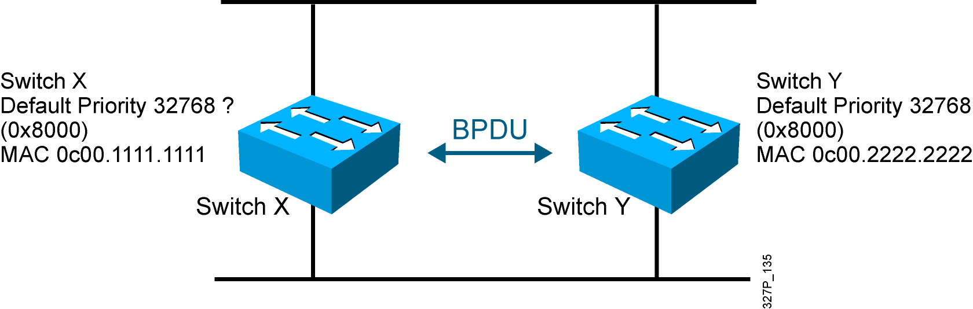
STP Root Bridge Selection
BPDU (default = sent every 2 seconds)
Root bridge = bridge with the lowest bridge ID
Bridge ID =
Bridge
Priority
MAC
Address
Notes:
Emphasize: By default, the switch with the lowest MAC address will be the root bridge.
Note: The Catalyst switches support an instance of spanning tree per VLAN. Each VLAN will use a unique MAC address for spanning tree purposes. On the Catalyst 1900, the address it uses for spanning tree is the MAC address on the various ports. VLAN is discussed in the next chapter.
The IEEE 802.1d specification specifies for a 16-bit priority field. The Catalyst 1900 switch only supports the 802.1d Spanning-Tree protocol. The default priority on the Catalyst 1900 is 32768 in decimal or 8000 in hex, the midrange value.
BPDU contain the following fields:
Protocol ID version
Message type
Flags
Root ID
Cost of path
Bridge ID
Port ID
Message age
Max age
Hello time
Forward delay

Slide 49
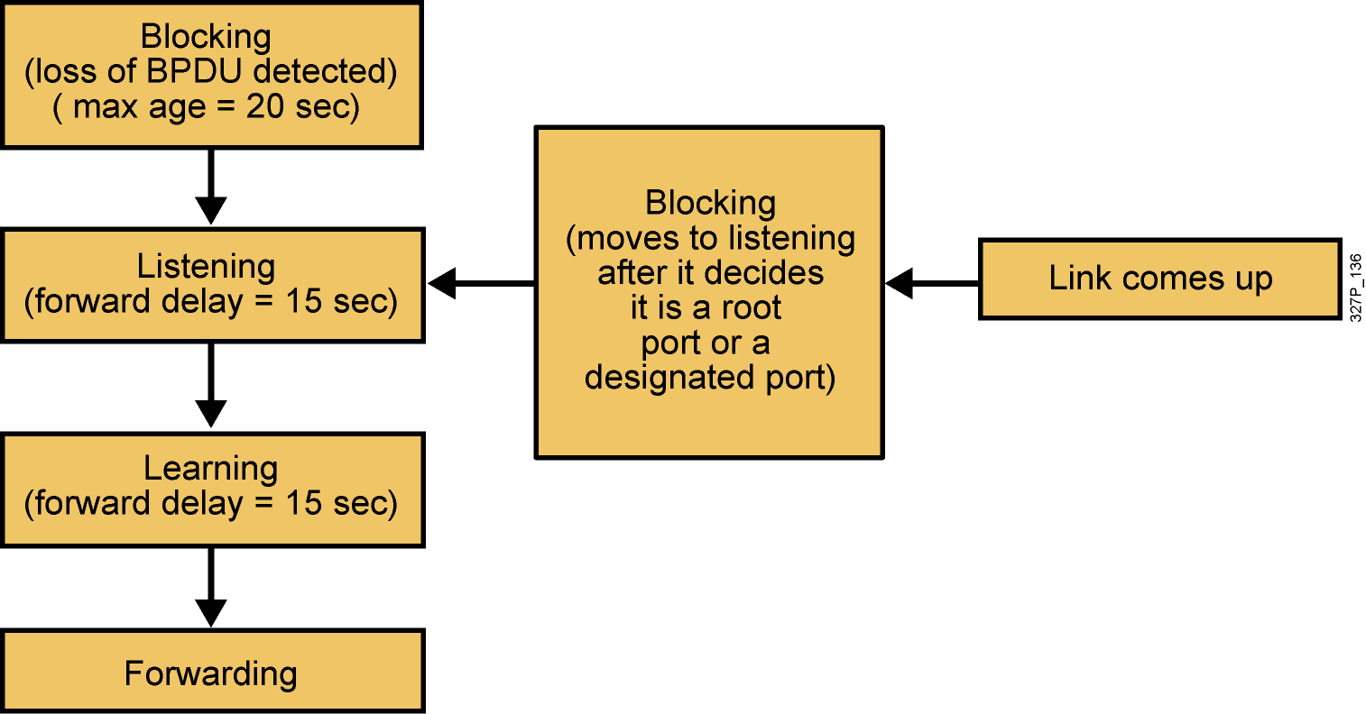
Spanning-Tree Port States
Spanning tree transits each port through several different states:
Notes:
Emphasize: Using the default Spanning-Tree protocol timers setting, the times it takes to go from the blocking state to the forwarding state is 50 sec (20 + 15 + 15).

Slide 50
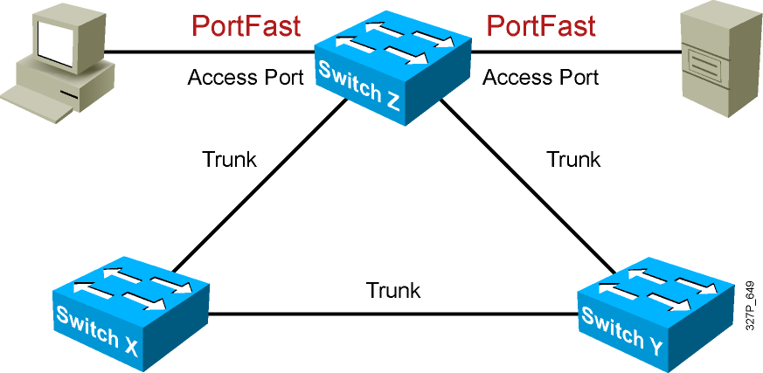
Describing PortFast
PortFast is configured on access ports, not trunk ports.

Slide 51
Configuring and Verifying PortFast
SwitchX(config-if)#
spanning-tree portfast
Configures PortFast on an interface
OR
SwitchX(config)#
spanning-tree portfast default
Enables PortFast on all non-trunking interfaces
SwitchX#
show running-config interface interface
Verifies that PortFast has been configured on an interface

Slide 52
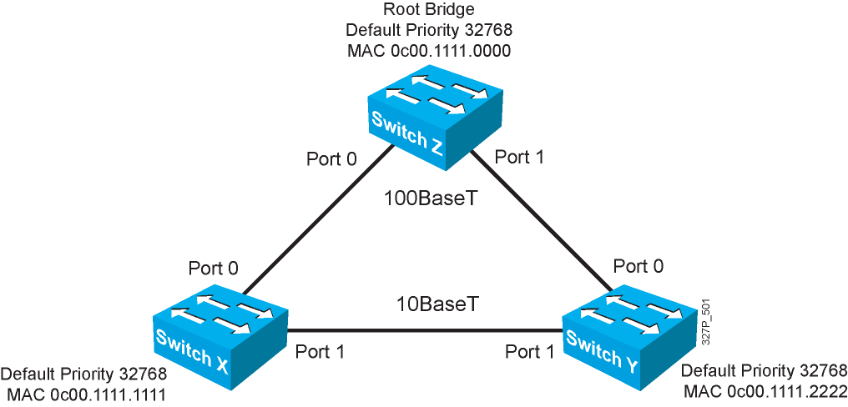
Spanning-Tree Operation Example
Notes:
Layer 2 of 2
Emphasize: Switch X and Y have the same path cost to the root bridge. The DP for the bottom segment is on switch X because switch X has a lower bridge ID than switch Y.

Slide 53
Spanning-Tree Path Cost
Link Speed | Cost (Revised IEEE Specification) | Cost (Previous IEEE Specification)
10 Gb/s | 2 | 1
1 Gb/s | 4 | 1
100 Mb/s | 19 | 10
10 Mb/s | 100 | 100
Notes:
Emphasize: There are two cost calculation methods. The Catalyst 1900 uses the older method. The new method is designed to accommodate the higher gigabit Ethernet speed.
Note:
Port priority is used to determine which path has preference when path costs are equal (for example, when you have two parallel links connecting two switches together). The default port priority is 128.
The port aggregation protocol and EtherChannels® are not taught in this class.
Fast EtherChannel is supported by the Catalyst 1900 switch.

Slide 54
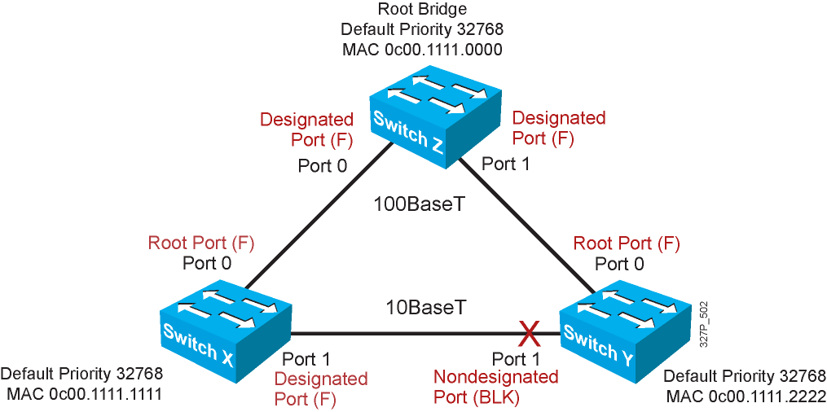
Spanning-Tree Recalculation
Notes:
Emphasize: RPs and DPs are normally in the forwarding state.
There is only one DP per segment.

Slide 55
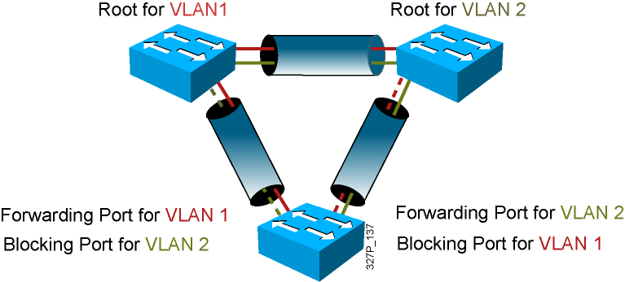
Per VLAN Spanning Tree Plus

Slide 56
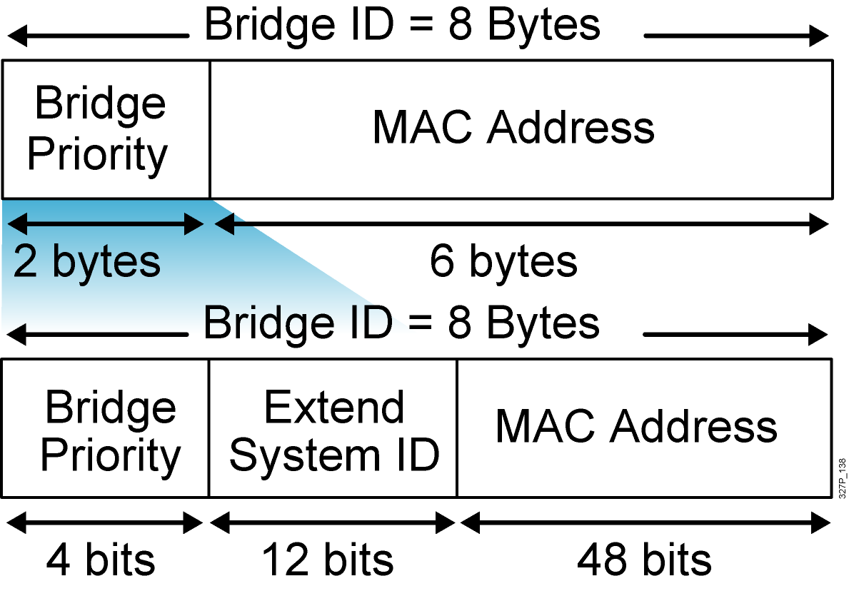

PVST+ Extended Bridge ID
Bridge ID without the extended system ID
Extended bridge ID with system ID
System ID = VLAN

Slide 57
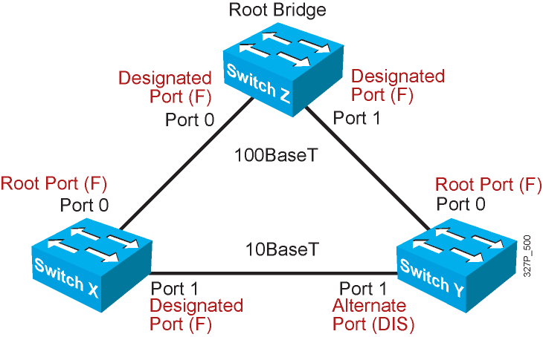
Rapid Spanning Tree Protocol

Slide 58




Default Spanning-Tree Configuration
Cisco Catalyst switches support three types of STPs:
PVST+
PVRST+
MSTP
The default STP for Cisco Catalyst switches is PVST+ :
A separate STP instance for each VLAN
One root bridge for all VLANs
No load sharing

Slide 59
PVRST+ Configuration Guidelines
Enable PVRST+.
Designate and configure a switch to be the root bridge.
Designate and configure a switch to be the secondary root bridge.
Verify the configuration.

Slide 60
PVRST+ Implementation Commands
SwitchX(config)#
spanning-tree mode rapid-pvst
Configures PVRST+
SwitchX#
show spanning-tree vlan vlan# [detail]
Verifies the spanning-tree configuration
SwitchX#
debug spanning-tree pvst+
Displays PVST+ event debug messages

Slide 61
Verifying PVRST+
SwitchX# show spanning-tree vlan 30
VLAN0030
Spanning tree enabled protocol rstp
Root ID Priority 24606
Address 00d0.047b.2800
This bridge is the root
Hello Time 2 sec Max Age 20 sec Forward Delay 15 sec
Bridge ID Priority 24606 (priority 24576 sys-id-ext 30)
Address 00d0.047b.2800
Hello Time 2 sec Max Age 20 sec Forward Delay 15 sec
Aging Time 300
Interface Role Sts Cost Prio.Nbr Type
-------- ----- --- --- -------- ----
Gi1/1 Desg FWD 4 128.1 P2p
Gi1/2 Desg FWD 4 128.2 P2p
Gi5/1 Desg FWD 4 128.257 P2p
The spanning-tree mode is set to PVRST.

Slide 62
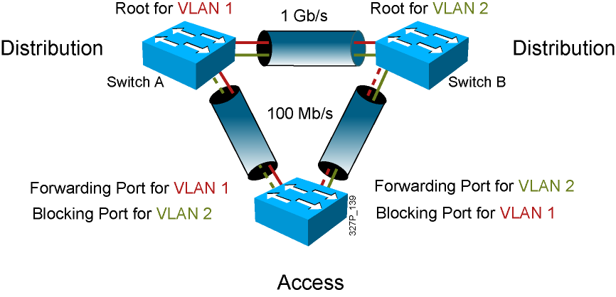
Configuring the Root and Secondary Bridges

Slide 63
Configuring the Root and Secondary Bridges: SwitchA
SwitchA(config)#
spanning-tree vlan 1 root primary
This command forces this switch to be the root for VLAN 1.
SwitchA(config)#
spanning-tree vlan 2 root secondary
This command configures this switch to be the secondary root for VLAN 2.
OR
SwitchA(config)#
spanning-tree vlan # priority priority
This command statically configures the priority (increments of 4096).

Slide 64
Configuring the Root and Secondary Bridges: SwitchB
SwitchB(config)#
spanning-tree vlan 2 root primary
This command forces the switch to be the root for VLAN 2.
SwitchB(config)#
spanning-tree vlan 1 root secondary
This command configures the switch to be the secondary root VLAN 1.
OR
SwitchB(config)#
spanning-tree vlan # priority priority
This command statically configures the priority (increments of 4096).

Slide 65
Summary
A redundant switched topology includes multihomed switches and EtherChannel.
A redundant switched topology causes looping issues such as broadcast storms.
The 802.1D STP establishes a loop-free network.
The original STP has been enhanced by PVST+ and RSTP.

